Slide 1
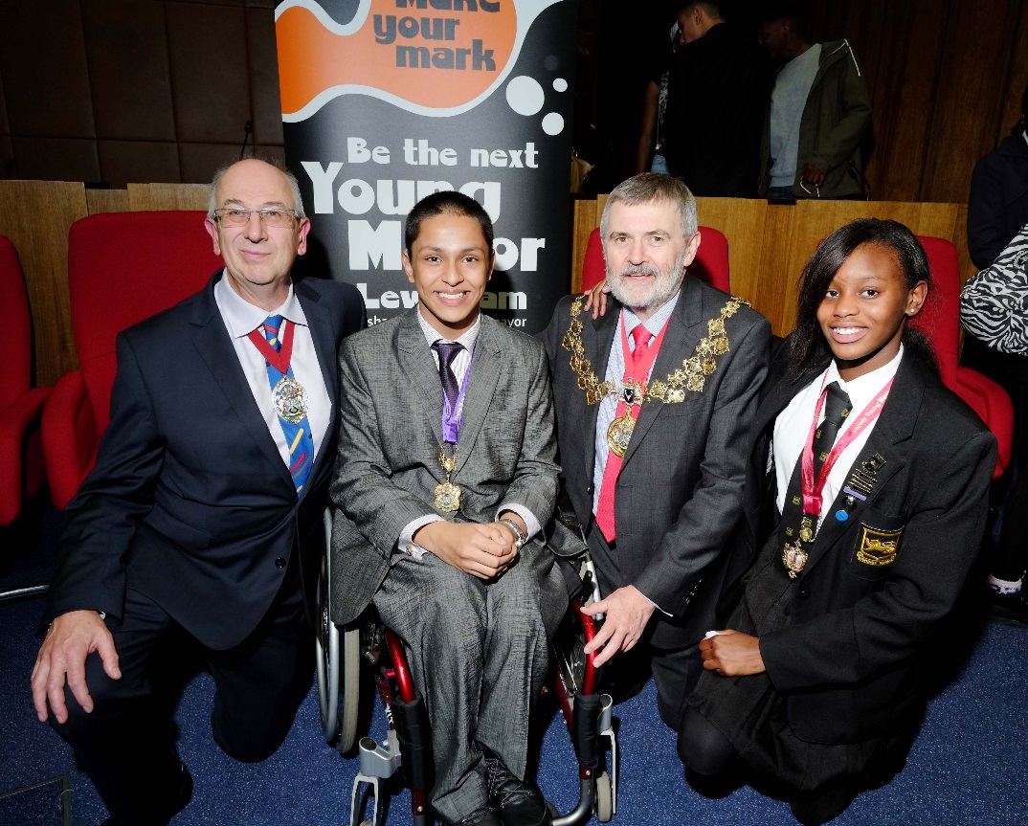
Liam Islam
Young Mayor of Lewisham
2014/15
Budget Presentation

Slide 2
Proposed Budget Reduction
The Young Mayor and Young Advisors have recommended that the Mayor reduce their annual budget by £5,000 to £25,000. This is in recognition of the fact that the Council is entering the 6th year of austerity and is expecting to continue to face very difficult financial challenges and pressures for at least four more years.
If this proposal is accepted the Young Mayor Team will be spending a maximum of £25K to deliver their commitments from now onwards. Like colleagues in the council we will continue to work with others and find new ways of working to ensure that young people in Lewisham have recognition and support for their ideas, interests and concerns.
Young people themselves are a great resource, have lots of energy and are committed in different ways to their communities. With less budget we will have to make more of working together, we are given a lot of support and commitment from others and this is a way of acknowledging the financial difficulties being faced across the borough and across the country.

Slide 3
Young Advisor’s Meetings
Mondays@ Civic Suite 5 - 7pm
Regular meeting time for young people to plan and organise their activities and for partners/ colleagues to consult and discuss issues with the group.
43 Young Advisor’s Meetings

Slide 4
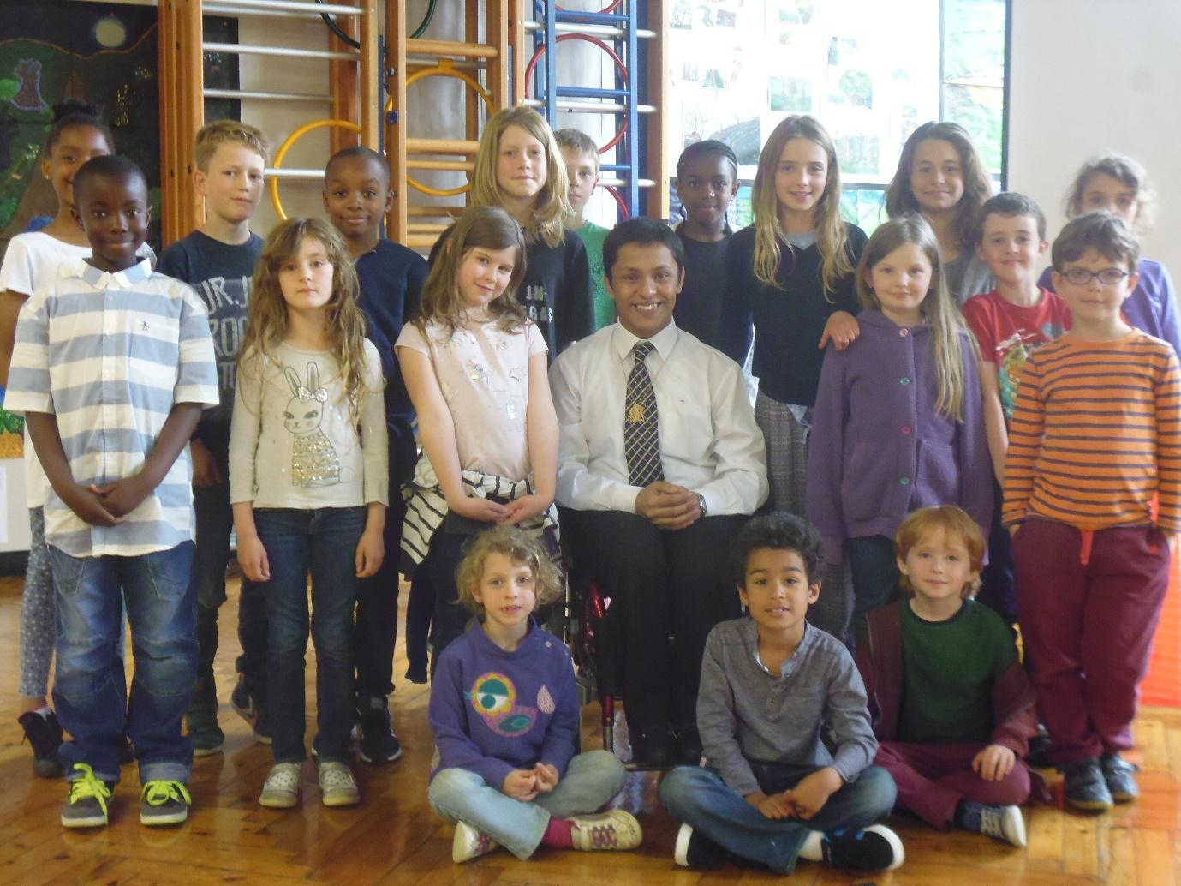
Working with Schools and Colleges
72 visits to primary, secondary schools and colleges: campaigning, raising awareness, budget consultations and feedback through assemblies, citizenship days and school councils. Supporting peers at exhibitions, achievement events and activities.
14 school visits to the civic suite including, school council meetings, primary school visits and Euroscola Project.
Termly School Council Meetings at the Civic Suite: hosted by the Young Mayor and Young Advisors with school council representatives

Slide 5
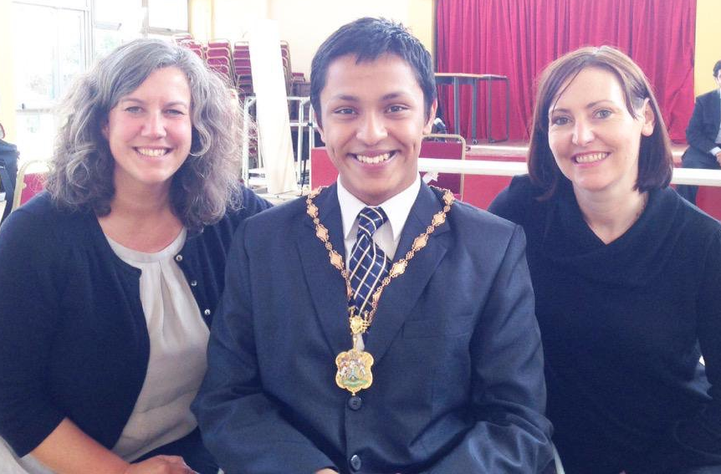
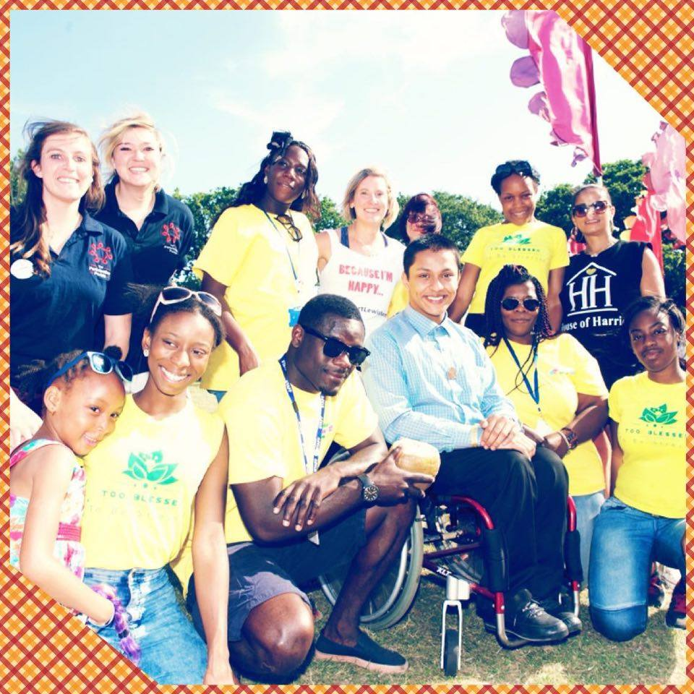
Civic events
Holocaust Memorial day
Magna Carta Liberteas Event
House of Lords Visit with Chair of Council and dignitaries
Unveiling of the Victoria Cross
Intergenerational Activities
Intergenerational Barbeque and Bowling at Ladywell Bowling Club
Quiz and Christmas Event with the Positive Aging Council
Big Lunch with POSAC

Slide 6
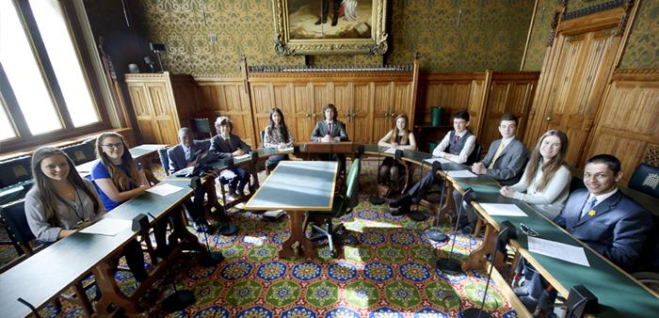
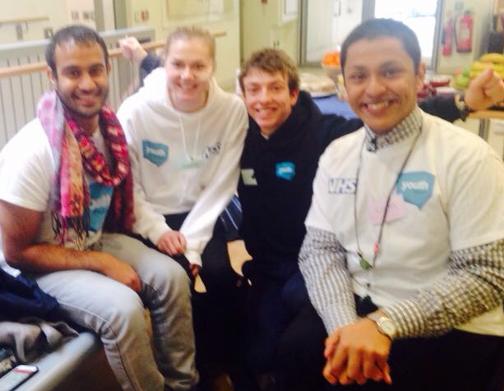
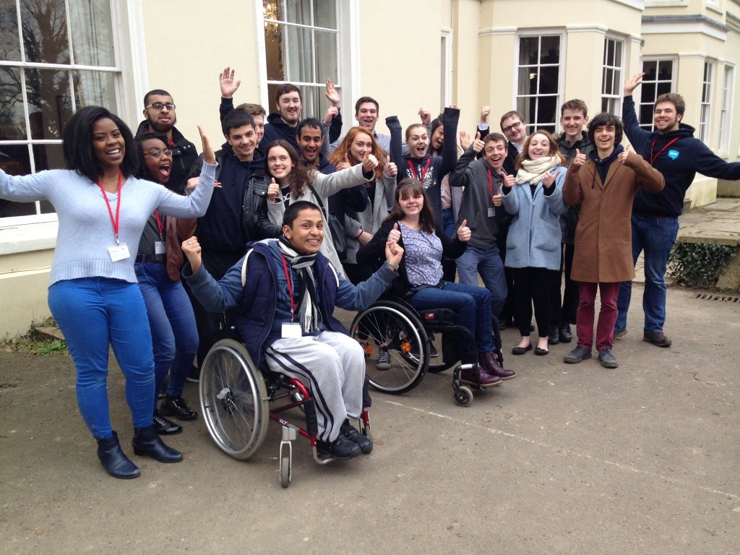
Health
London Region Representative to the NHS Youth Forum
British Youth Council’s Youth Select Committee on Mental Health at the House of Commons
Working with the Lewisham Headstart Project to improve young people’s mental health and well being including organising events and consultations in schools and in the community.
Working with Healthwatch as Healthwatch Champions
School Nurse Consultation
Sexual Health Services Consultation

Slide 7
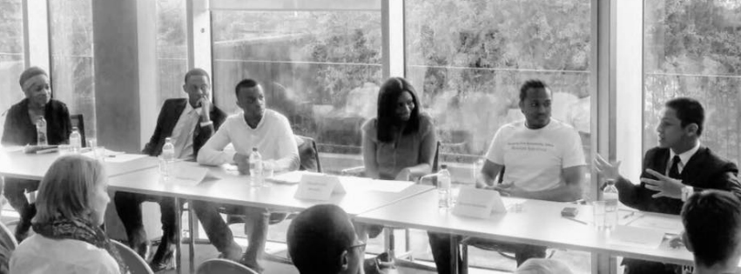
Social Justice and Diversity
Termly SEN Young People’s Forum
Contributing to the Black Staff Forum discussing young people aspirations, hopes and fears
Attending and contributing to discussions at the South London and Kent Islamic Centre
Contributing to the Anti –bullying conference
Workshop with Metro to better understand the experiences of young people who are LGBTQ
Organising an International Women’s Day Event at TNG

Slide 8
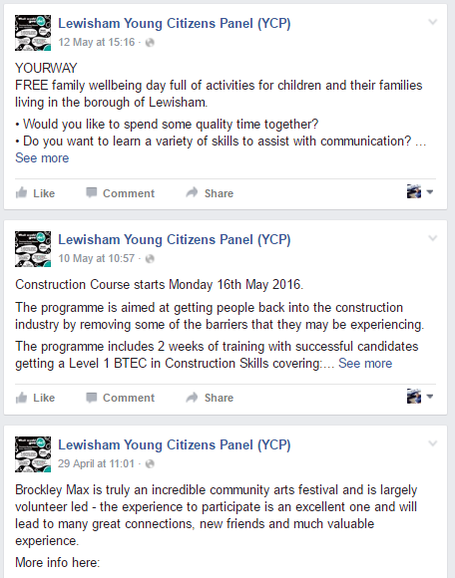
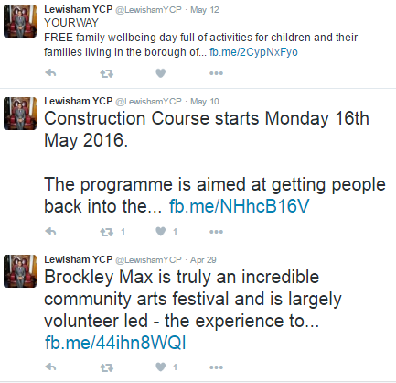
Employment and Enterprise
Making Christmas decorations and taking part in Sydenham Market
40 young people on work experience working on the voter registration campaign
Supporting and sending out job and training opportunities for young people on social media

Slide 9
Working with CYP, Lewisham Youth Service and Voluntary Sector
Contributing to the Children and Young People’s Plan
Consultation on changes to the Youth Service
Participating in the YOU Challenge with Uniform Groups
Stephen Lawrence Centre Panels
Meeting with CYP Select Committee about in depth review
Interviewing for the Director Of Children's Services
Albany Showcase and Open Mic Nights at TNG

Slide 10
Community Safety, Policing and Youth Justice
Taking part in the Safer Neighbourhood Board
Meeting and talking to the new Superintendents about young people in Lewisham
Participating and helping to organise stop and search workshops and events with the Stop and Search Sub group.
Discussion with the YOS Participation Group
Attending the launch and talking to the Athena group about young people and domestic violence

Slide 11
UK Youth Parliament, British Youth Council and Regional Work
UK Youth and British Youth Council: Engagement with the national Youth Participation strategies and meeting other young people who are representing their areas.
Participation in “Make your Mark” ballot to decide on the national campaigns.
Children’s Commissioner's Takeover Day
National Sitting at House of Commons
Launching the “Vision for Young Londoners” with the Partnership for Young London
Four week Voter Registration campaign
Visit to House of Lords
Votes at 16 Campaign

Slide 12
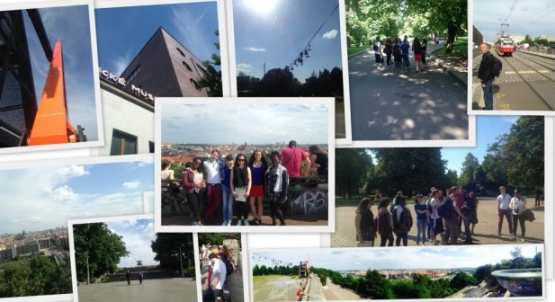
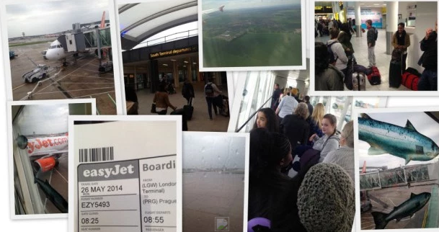
European Visits/ Visitors
Youth in Action projects (European funded projects) with youth democracy groups in Sortland, Norway, Alingsas in Sweden and Prague 7 in the Czech Republic
Visit to Zagreb, Croatia as a partner in “building blocks” YIA Project looking at re using of spaces and creativity.
Young Advisors were invited to run a workshop at the World Democracy Forum in Strasbourg for the Council of Europe
Visitors from Santa Maria da Feira in Portugal who have since implemented their own Young Mayor Programme.

Slide 13
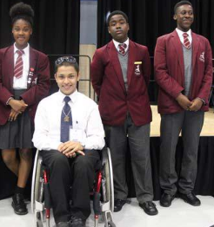
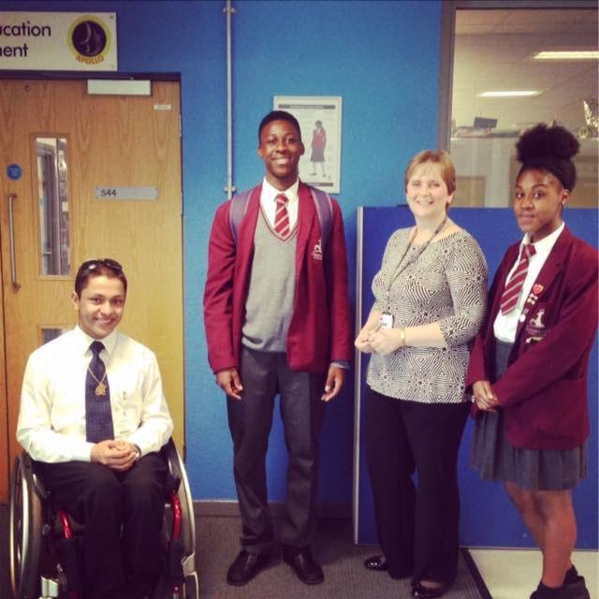
How we developed the budget proposals
Discussions at Young Mayor and Young Advisors – initial ideas
Consultations at schools, school councils, youth clubs and projects to gather more ideas, including feedback from St Dunstan’s, Bonus Pastor, Trinity, Sydenham, School, Prendergast Ladywell Fields college, Sedgehill School, Forest Hill School, Lewisham College, Drumbeat Sixth Form, Horniman Youth Panel, NEET traineeship, School council meeting, Young Carers, Lewisham Youth Theatre, TNG, Lewisham YOS participation group.
Feedback discussed at Young Advisors, ideas became proposals for inclusion in newsletter that went to all schools and online
Most popular ideas made into final proposals and agreed at Young Advisors Meeting.
Today presenting proposals to Mayor and Cabinet

Slide 14
Some of the Consultation Outcomes
Events to showcase talent – anyone can contribute
Drama – young people write and perform plays
More junior gyms /longer time slots /outside gyms
Encourage youth to cook healthy, cost effective food
Awareness about obesity
More TAs in schools as its important for students mental health
Working together and with charities
More projects to teach about different cultures and religions
Cleaning up the streets day
People don’t understand the difficulty of disability and young people
Better facilities and ramps, more accessible places
PSHE at schools should be used to talk about real life e.g.: mortgages, rent and tax, schools only educate us knowledge wise and don’t provide us with the life skills to help us use our knowledge
More work experience, Better work experience, Younger work experience
More experience and summer jobs for people
More promotion of local festivals and events/concerts that talented people can get involved in
Support creative ideas to help the community
Current young mayor can create a pot of money to help groups out

Slide 15
There are 3 Budget Proposals:
1. Young People’s Funding Pot £10,000
Young People are interested in running and organising their own projects and in order to try and address some of the interests in the consultation. Young people will be able to apply to this pot to fund activities. Activities which meet the needs and interests in the consultation will be funded. The kind of projects that could be funded are :
Arts showcases
Sports tournaments particularly interschool/club/borough/faith Healthy eating competition
Environment Days
Young people will need to do an application form and meet with Young advisors.

Slide 16
2. Work Experience and Employability £7,500
Building on the work with Urban Synergy to develop the work experience project with young people from youth clubs during the holidays to access Canary Wharf /other professions which they would otherwise not be able to experience. This project will include working with special needs schools/ SEN forum to extend the opportunities for young people with additional needs. This could take the form of small group visits/workshops with staff and visits to different work places. Additional work experience for young people during the school holidays.

Slide 17
3. Pilot scheme working with colleagues and partners around accessibility to shops and town centres £7,500
Identify a future development and work with politicians and local young people who use wheelchairs to ensure the developments are as accessible as possible. To include visits for young people and adults to different sites, identifying what works well and how accessibility can be improved. Particularly in local shops and services that young people use /would like to use, how small improvement

Slide 18
Have you any questions?
We request that the Mayor approves these budget proposals
Thank you for your support and for listening to our presentation

